Slide 1

Welcome to the
Bengaluru, India

Slide 2


Our Supporters

Slide 3

If you have questions about the event or to report any issues
Use the HASHTAG
#askgab19
And the organizers and volunteers will try to support!

Slide 4
Please share our event on the WWW by any means
Use the HASHTAG
#gabblr19
extensively

Slide 5

Sowmya Srinivas
Azure Engineer in Omnio Global based in London
9+ years of IT industry experience in Application development and Azure cloud technology.
Speaker and Corporate Trainer
Gmail ID: mvsowmyashree@gmail.com

Slide 6
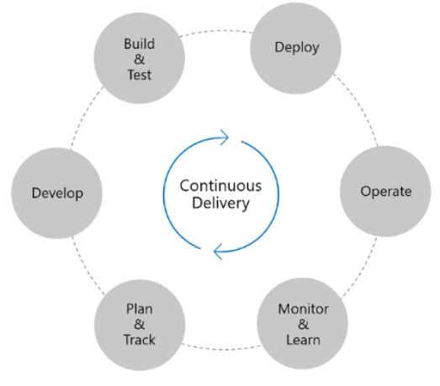
Introduction to Azure Devops
DevOps is the union of people,process and products to enable continuous delivery of value to your end users.

Slide 7
Agenda
Introduction
Key Features
Hosted Agents
Demos
Key Benefits

Slide 8
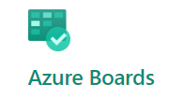
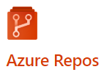
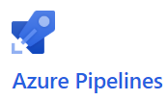
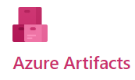

Azure Devops Services
Features:

Slide 9
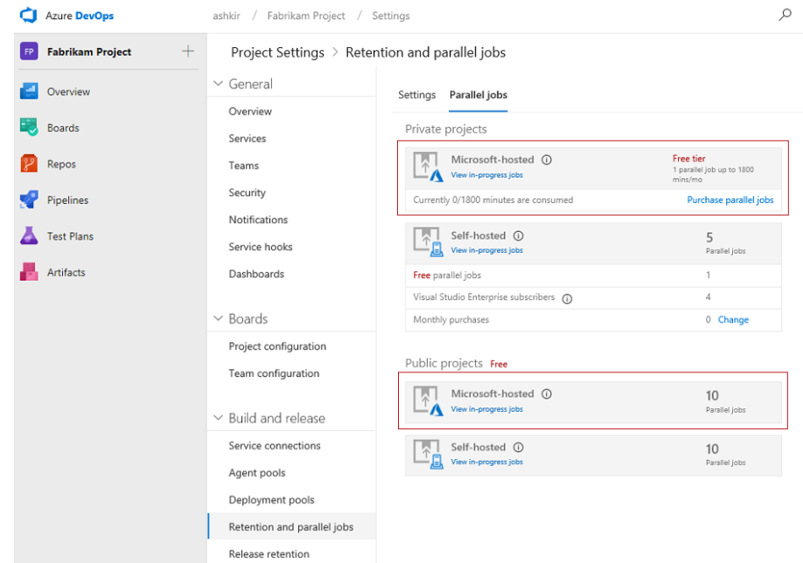
Agents
Microsoft-Hosted Agent
Self-Hosted Agent

Slide 10
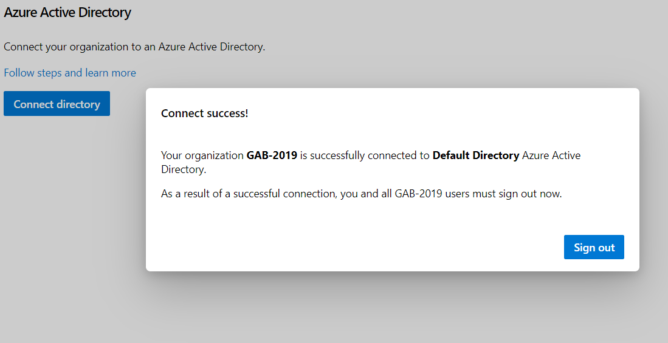
Demo 1:
How to Create:
Organisation
Project
Service Connection-Using PAT and Service principal
How to Connect to Azure AD

Slide 11
Demo 2: Manual CICD Process
How to clone Azure repo to local machine
How to get the code to Azure Repos
How to create build pipeline and execute it manually.
How to create release pipeline and execute and deploy to Azure webapp services manually.

Slide 12
Demo 3: Automated CICD process with Approval and Gates
How to create build pipeline and execute it automatically.
How to create release pipeline and execute and deploy to Azure webapp services automatically.
How to enable approvals(Pre and post) for each phase of release pipeline.
How to enable Gates for each phase of release pipeline.
How schedules Azure pipelines.

Slide 13
Key Benefits:
More structure
Higher quality
Faster delivery
Automated Process

Slide 14
Referred Links:
https://docs.microsoft.com/en-us/azure/devops/user-guide/what-happened-vsts?view=azure-devops
https://docs.microsoft.com/en-us/azure/devops/organizations/accounts/use-personal-access-tokens-to-authenticate?view=azure-devops
https://docs.microsoft.com/en-us/azure/deops/pipelines/agents/agents?view=azure-devops
https://docs.microsoft.com/en-us/azure/devops/pipelines/release/approvals/?view=azure-devops
https://azuredevopslabs.com/labs/vstsextend/azuredevopsprojectdotnet/

Slide 15
Find all the online locations here
Join our Meetup group here
http://bit.ly/azrmeetup
Check the event photos here
http://bit.ly/gab19-photos
Note: You could also upload your selfies and other photos you have taken at the event
Check slide decks and other samples presented at the event here
http://bit.ly/gab2019-repo

Slide 16

Thanks!

